Slide 1
Twitter Sentiment Analysis
ECE–602 (Product Design) – Project_2
- Harshit Agrawal

Slide 2

Introduction
Twitter Sentiment Analysis using Python
This presentation covers the sentiment analysis of any query by parsing the tweets fetched from Twitter using Python.
Positive, Negative and Neutral Analysis of parsed tweets.

Slide 3
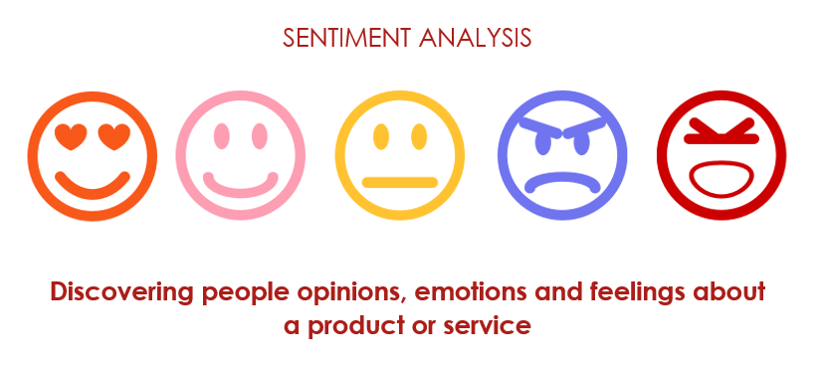
What is Sentiment Analysis?
Sentiment Analysis is the process of ‘computationally’ determining whether a piece of writing is positive, negative or neutral. It’s also known as opinion mining, deriving the opinion or attitude of a speaker.

Slide 4
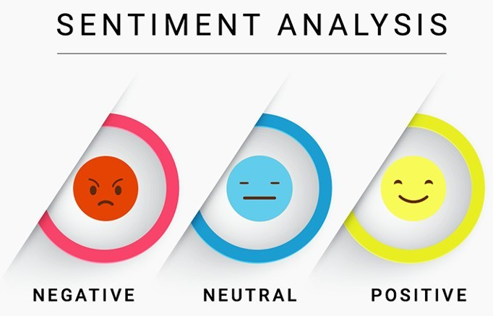

Slide 5
Why Sentiment Analysis?
Business: In marketing field companies use it to develop their strategies, to understand customers’ feelings towards products or brand, how people respond to their campaigns or product launches and why consumers don’t buy some products.
Politics: In political field, it is used to keep track of political view, to detect consistency and inconsistency between statements and actions at the government level. It can be used to predict election results as well!
Public Actions: Sentiment analysis also is used to monitor and analyse social phenomena, for the spotting of potentially dangerous situations and determining the general mood of the blogosphere.

Slide 6

Twitter
Python
Twitter is an online news and social networking service on which users post and interact with messages known as "tweets".
Python is an interpreted high-level programming language for general-purpose programming.

Slide 7
Implementation
Authorize twitter API client.
Make a GET request to Twitter API to fetch tweets for a particular query.
Parse the tweets. Classify each tweet as positive, negative or neutral.

Slide 8
APIs Installed
Tweepy: tweepy is the python client for the official Twitter API. Install it using following pip command:
pip install tweepy
TextBlob: textblob is the python library for processing textual data. Install it using following pip command:
pip install textblob
3. Corpora: A large and structured set of texts. Install using following command
python -m textblob.download_corpora

Slide 9
Tweepy
Tweepy is open-sourced, hosted on GitHub and enables Python to communicate with Twitter platform and use its API.
Tweepy supports accessing Twitter via Basic Authentication and the newer method, OAuth. Twitter has stopped accepting Basic Authentication so OAuth is now the only way to use the Twitter API.
Tweepy provides access to the well documented Twitter API. With tweepy, it's possible to get any object and use any method that the official Twitter API offers.
One of the main usage cases of tweepy is monitoring for tweets and doing actions when some event happens.

Slide 10
TextBlob
TextBlob is a Python library for processing textual data. It provides a simple API for diving into common natural language processing (NLP) tasks such as part-of-speech tagging, noun phrase extraction, sentiment analysis, classification, translation, and more.
Features:
Noun phrase extraction
Part-of-speech tagging
Sentiment analysis
Classification (Naive Bayes, Decision Tree)
Language translation and detection powered by Google Translate
Tokenization (splitting text into words and sentences)
Word and phrase frequencies
Parsing
n-grams
Word inflection (pluralization and singularization) and lemmatization
Spelling correction
Add new models or languages through extensions
WordNet integration

Slide 11
Authentication
In order to fetch tweets through Twitter API, one needs to register an App through their twitter account.
Creating New App from apps.twitter.com and filling the application details.
Once the app is created, from the app page open the ‘Keys and Access Tokens’ tab.
Copy ‘Consumer Key’, ‘Consumer Secret’, ‘Access token’ and ‘Access Token Secret’.

Slide 12
Test Case Example
Input = “ Donald Trump”
Output required = “ Positive tweet Percentage for random 10 tweets”
Output obtained = “ ………example”
In this example, we can see that the tweets were first fetched using tweepy and then parsed into the function to split.
The split words are then parsed into TextBlob to create blobs which carry weights of sentiment. In other words, they return the polarity.
If the polarity of the expression after classification is > 0 then sentiment is POSITIVE
If the polarity of the expression after classification is < 0 then sentiment is NEGATIVE
Else the polarity is 0 and the sentiment is NEUTRAL.

Slide 13
Future Scope:
Speech Recognition and Talk Back
The speech recognition module in python is imported and along with it, the GTTs module is also imported to provide the text to speech and speech to text conversion.
The flow of the program is such, that it generates a generic threshold value based on the noise in the surroundings. Then it asks for an input.
Upon giving that input, the program knows what kind of frequency is expected from the user.
As soon as the user provides the hashtag, it registers it, passes it on to the fetching function and then parses on to process it from the 10 tweets parsed.
After parsing the system generates an output which is stored in a voice, and the voice note is returned out to the user, creating a replica of human talk back feature.

Slide 14
Conclusion
The program for Twitter sentiment analysis using Python generates accurate results for non-sarcastic tweets which mention the specified hashtag. However, the program fails to take into consideration sarcasm and the accuracy drops down heavily.
The Google Text To Speech feature and the Voice Recognition UI works perfectly fine for less noisy environments and the processing lag is just 2 sec.
Whereas for more noisy environment, when the threshold is above 10,000hz the processing lag is around 6-7 sec.

Slide 15
References
http://www.ijcaonline.org/research/volume125/number3/dandrea-2015-ijca-905866.pdf
https://textblob.readthedocs.io/en/dev/quickstart.html#sentiment-analysis
textblob.readthedocs.io/en/dev/_modules/textblob/en/sentiments.html
Vox.com
Wikipedia.com
Google.com

Slide 16
Thank You.

